Slide 1
YRE Presentation
By Aimée Savage and Lucy Winton

Slide 2
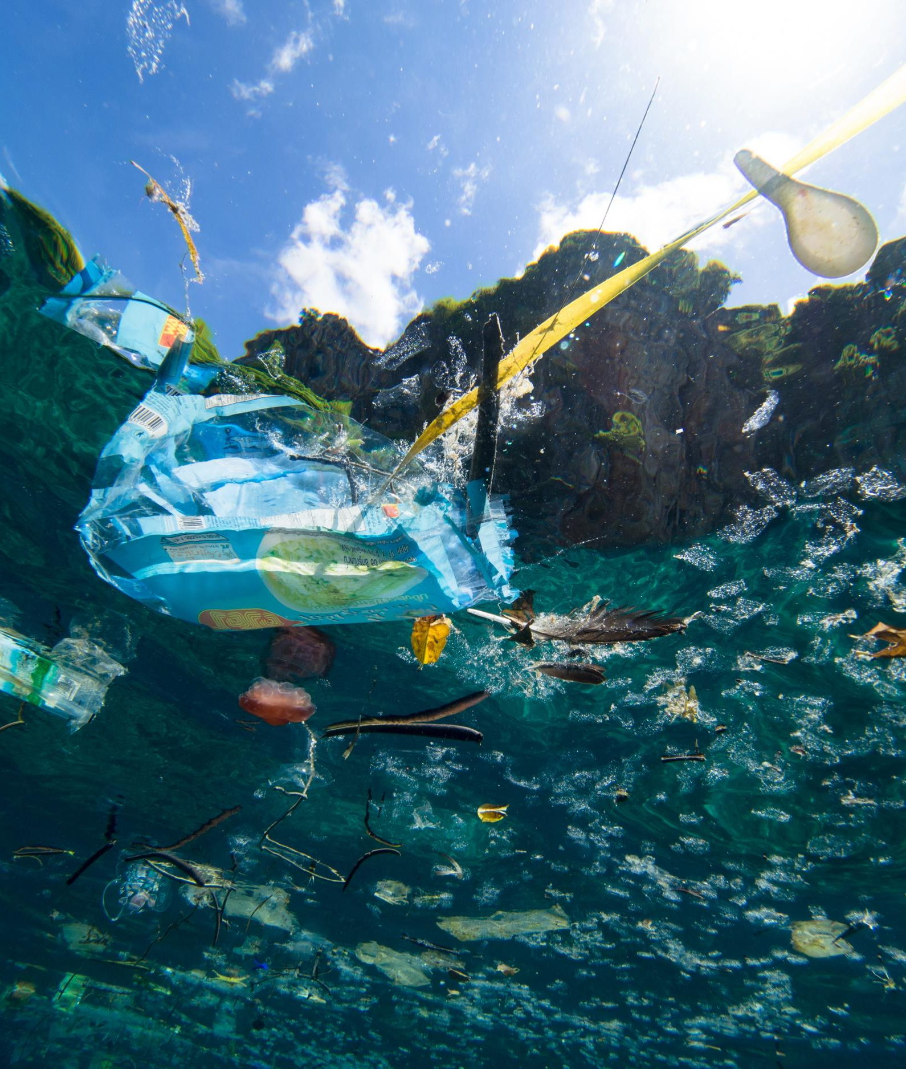
What is Plastic Ocean Pollution?
Plastic ocean pollution is tons of plastic debris (which by definition are waste that can vary in size from large containers, fishing nets to microscopic plastic pellets or even particles) which are discarded every year, everywhere, polluting lands, rivers, beaches and oceans

Slide 3
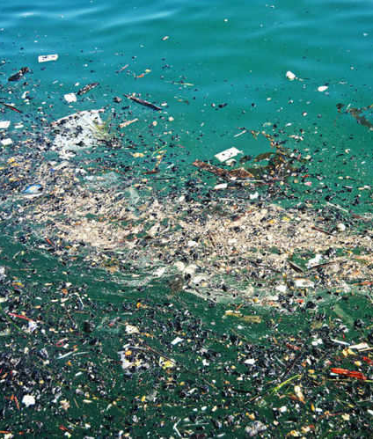
How much plastic is thrown into the ocean each year?
In a more direct route, boaters may dump their waste right into the sea. In the past this has been the main cause of plastics in the ocean. In 1975, the National Academy of Sciences estimated that 14billion (6,350,293 tonnes) pounds of rubbish was being dumped into the ocean per year. That’s more than 1.5million (680 tonnes) pounds per hour!

Slide 4
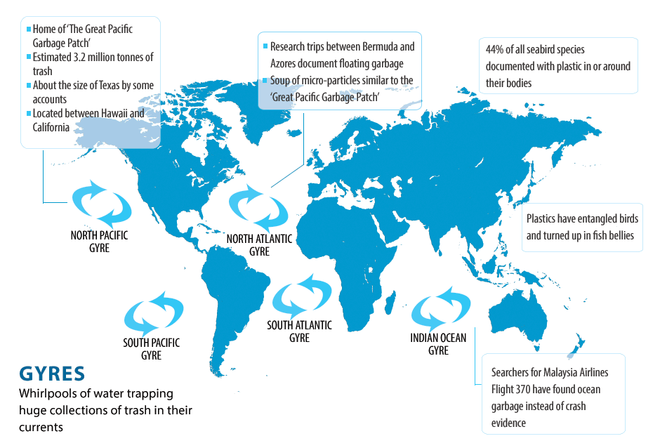
What is a Gyre?
A Gyre is almost like a floating island of rubbish. It is a whirlpool that sucks in the rubbish nearby and it just sits there, polluting the ocean
There are five gyres, one in each ocean

Slide 5
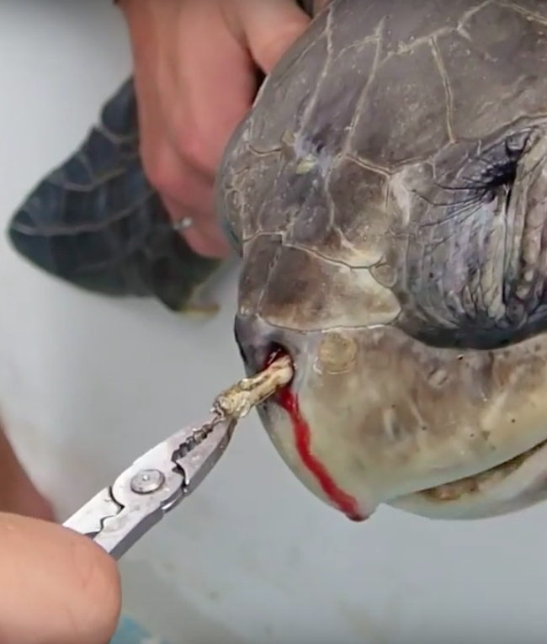
How much Marine Life is Killed per year due to plastic pollution?
Roughly 100,000 marine life is Killed a year due to plastic, and these are only ones found! There is a lot more out there!
Approximately 1 million sea birds also die from plastic. A plastic bag can kill numerous animals because they take so long to disintegrate.

Slide 6
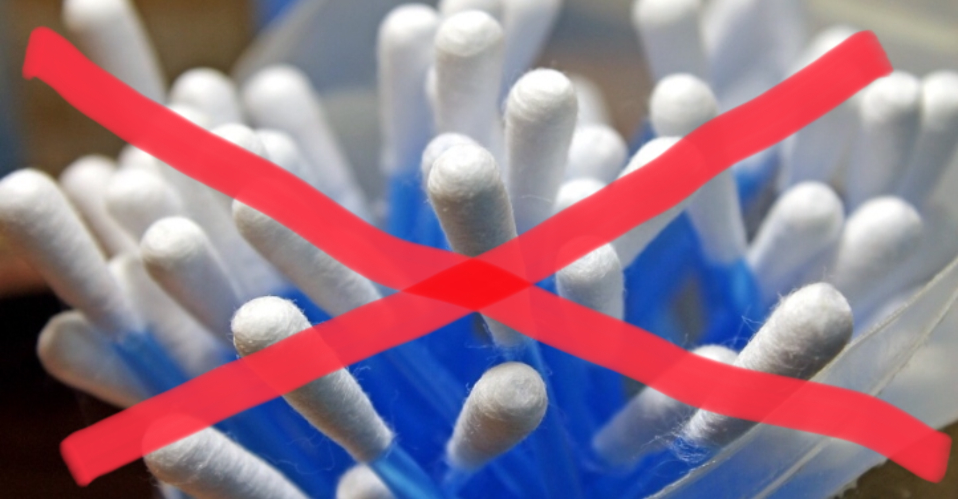
What is the UK doing to help?
Plastic beads in toothpaste and face scrubs have been banned, and some parts of the UK have stopped using plastic cotton buds, as people flushed them down the toilet!

Slide 7
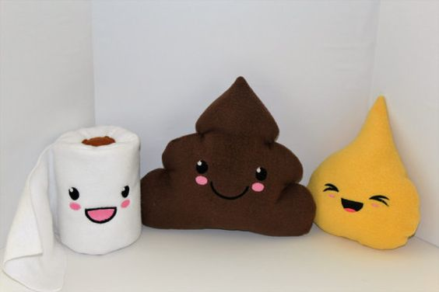
What can you do to help?
You can start by using the right bins! If you put plastic in the black bin, it goes to a landfill, and it may be blown out by the wind and hurt an animal
You can flush only the 3 P’s down the toilet!

