Slide 1
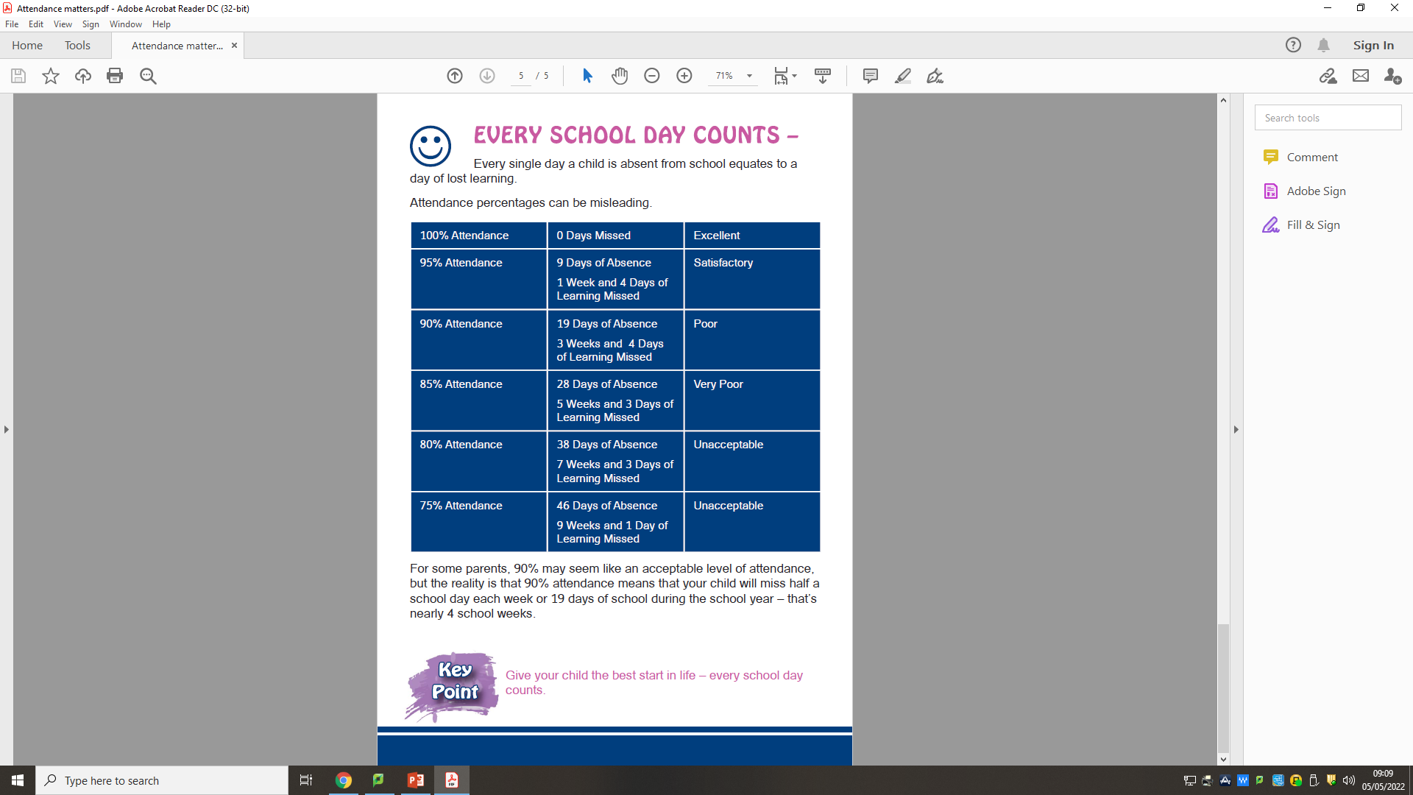
SCHOOL ATTENDANCE MATTERS: A PARENT’S GUIDE
Good attendance at school is important to allow a young person to fulfil their potential. School is where they learn, have fun, gain qualifications, develop new skills, build confidence and self-esteem.
Young people who regularly miss school without good reason are missing out on all of this and are likely to become isolated from their friends and underachieve.
Making sure your child goes to school is your legal responsibility.
At Wallace, once a child’s attendance drops below 95% then it becomes a concern as learning is being lost. At this stage your child’s Head of Year will write to you identifying the concern and invite you in to school to discuss the issue and offer support.
At 85% then your child’s absence from school has become a persistent problem. At this stage we have a duty of care to report the absence of any pupil to EA’s Educational Welfare Service for support.
An Attendance Review Panel will deal with persistent absenteeism below 80%.
WHAT TO DO IF MY CHILD IS ABSENT?
Always inform the school if your child is absent.
Contact us as soon as possible on the first day of absence.
Complete the digital online absence reporting form on the website explaining the absence on the first and subsequent days of absence.
Always inform your child’s Head of Year of any problems or difficulties as soon as they arise so staff can help and be supportive.
Support the school if or when attendance becomes a persistent problem.

